Slide 1
HYDRAULICS & HYDRAULIC MACHINES

Slide 2
Unit 1: uniform flow in open channels

Slide 3
Learning Outcome
In this unit, you will learn
Definition of channel flow
Differences between pipe flow and open channel flow.
Classification of channels
Types of flow in channels
Geometric properties of channels
Chezy’s and Manning’s equations of uniform flow
Most economical channel sections

Slide 4
Definition
A channel is defined as a passage through which flow takes place under atmospheric pressure
Flow in an open channel is the flow of a liquid with a free surface

Slide 5
Comparison of Pipe flow & Open channel flow
Pipe flow | Open channel flow
1. There is no free water surface. | There is a free water surface
2. Flow takes place due to pressure | 2. Flow takes place due to gravity
3. HGL is obtained by joining piezometric levels at different sections | HGL coincides with the free water surface

Slide 6
Classification of channels
1. Natural channels
2. Artificial channels
3. Open channels
4. Closed channels
5. Rectangular channels
6. Triangular channels
7. Trapezoidal channels
8. Circular channels
9. Prismatic channels
10. Non-prismatic channels

Slide 7
Natural & Artificial channels

Slide 8
Types of flow
Flow in open channel is classified as follows
Steady & Unsteady flow
Uniform & non-Uniform flow
Laminar & Turbulent flow
Subcritical, critical & supercritical flow

Slide 9
Geometric Properties of open channels
.1. Depth of flow ‘y’ is the vertical distance of the lowest point of a channel section from the free surface
2. Top width ‘T’ is the width of the channel section at the free surface.
3. Wetted Area ‘A’ is the cross-sectional area of the flow normal to the direction of flow.
4. Wetted perimeter ‘P’, is the length of the line of intersection of the channel wetted surface with a crosssectional plane normal to the direction of flow.
5. Hydraulic radius, ‘R’ = A/P, is the ratio of the wetted area to its wetted
perimeter. Also known as hydraulic mean depth
6. Hydraulic depth, ‘D’ = A/T, is the ratio of the wetted area to the top width.

Slide 10
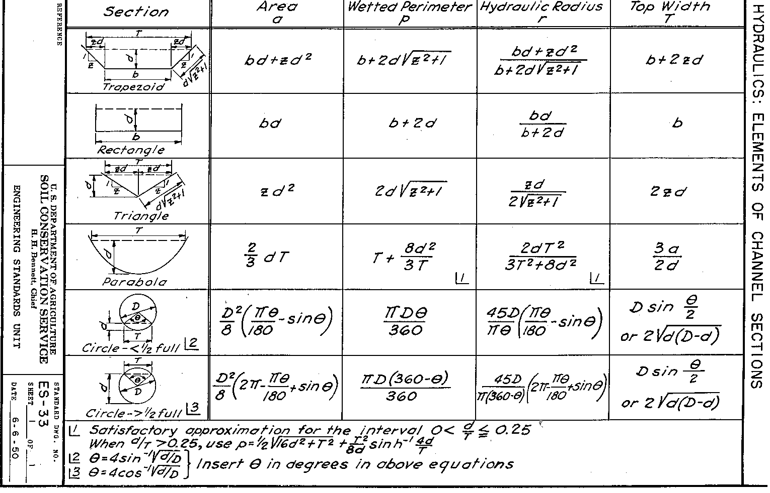
Geometric Properties of open channels - contd

Slide 13
Uniform flow in open channel

Slide 14
Chezy’s equation
V = C √RS
V= Velocity of flow
C = Chezy’s constant
R = Hydraulic mean depth
S = Slope of the channel bottom

Slide 15
Manning’s equation
V= (1/n)R^{(2/3)}S^{(1/2)}
V= Velocity of flow
n = Manning’s constant
R = Hydraulic mean depth
S = Slope of the channel bottom

Slide 16
Most economical channel section
A channel section is considered to be most economical if it can pass a maximum discharge for a given cross sectional area, resistance coefficent and bottom slope.

Slide 17
Most economical Rectangular channel section
B= y/2
Or
y = 2B
And
R = y/2

Slide 18
Most economical Triangular channel section
θ = 45°
or
Side slope Z = 1
and
R= y/(2√2)

Slide 19
Most economical Trapezoidal channel section
Half top width = length of sloping side
i.e., B + 2ZY = 2y√(1+Z²)
and
R= y/2
If a semicircle is drawn with midpoint of the topwidth as centre and depth of flow as radius then the three sides of the most economical trapezoidal channel will be tangential to the semi circle.

Slide 20
Most economical Circular channel section
A circular channel is called most economical if any of the following is satisfied
a) it passes maximum discharge
b) the flow has maximum mean velocity

Slide 21
Most economical Circular channel section
Condition for maximum discharge:
Θ = 154°
R = 0.28D
y = 0.95D

Slide 22
Most economical Circular channel section
Condition for maximum discharge:
Θ = 128.75°
R = 0.3D
y = 0.81D

Slide 23
Open channels - examples

Slide 24
Open channels - examples

Slide 25
Open channels - examples

Slide 26
Open channels - examples

Slide 27
Open channels - examples

Slide 28
Open channels - examples

Slide 29
PROBLEMS
End
1. A trapezoidal channel has a base width b = 6 m and side slopes 1H:1V. The channel bottom slope is So = 0.0002 and the Manning roughness coefficient is n = 0.014. Compute
a)the depth of uniform flow if Q = 12.1 m3/s
b)the state of flow

Slide 30
Additional References
1.A Text Book of Fluid Mechanics & Hydraulic Machines – R.K. Rajput, S. Chand & Co., New Delhi 2006 Edition.
2. Principles of Fluid Mechanics & Fluid Machines – N.NarayanaPillai, S. Universities Press (India)., Hyderabad 2009 Edition.
3.A Text Book of Fluid Mechanics & Hydraulic Machines – R.K. Bansal, Laxmi Publications., New Delhi 2008 Edition.
4.Fundamentals of Fluid Mechanics– B.R.Munson, D.F.Young, T.H.Okishii, Wiley India, New Delhi 2009 Edition.

Slide 31

Questions
1. Define: open channel flow
2. Differentiate between open channel flow and pipe flow
3. Derive the conditions for most economical rectangular channel section
4. Derive the conditions for most economical triangular channel section
5. Derive the conditions for most economical trapezoidal channel section
6. Derive the conditions for most economical circular channel section for maximum discharge and maximum velocity

